Slide 1


NOABORTIONAMENDMENT.COM

Slide 2
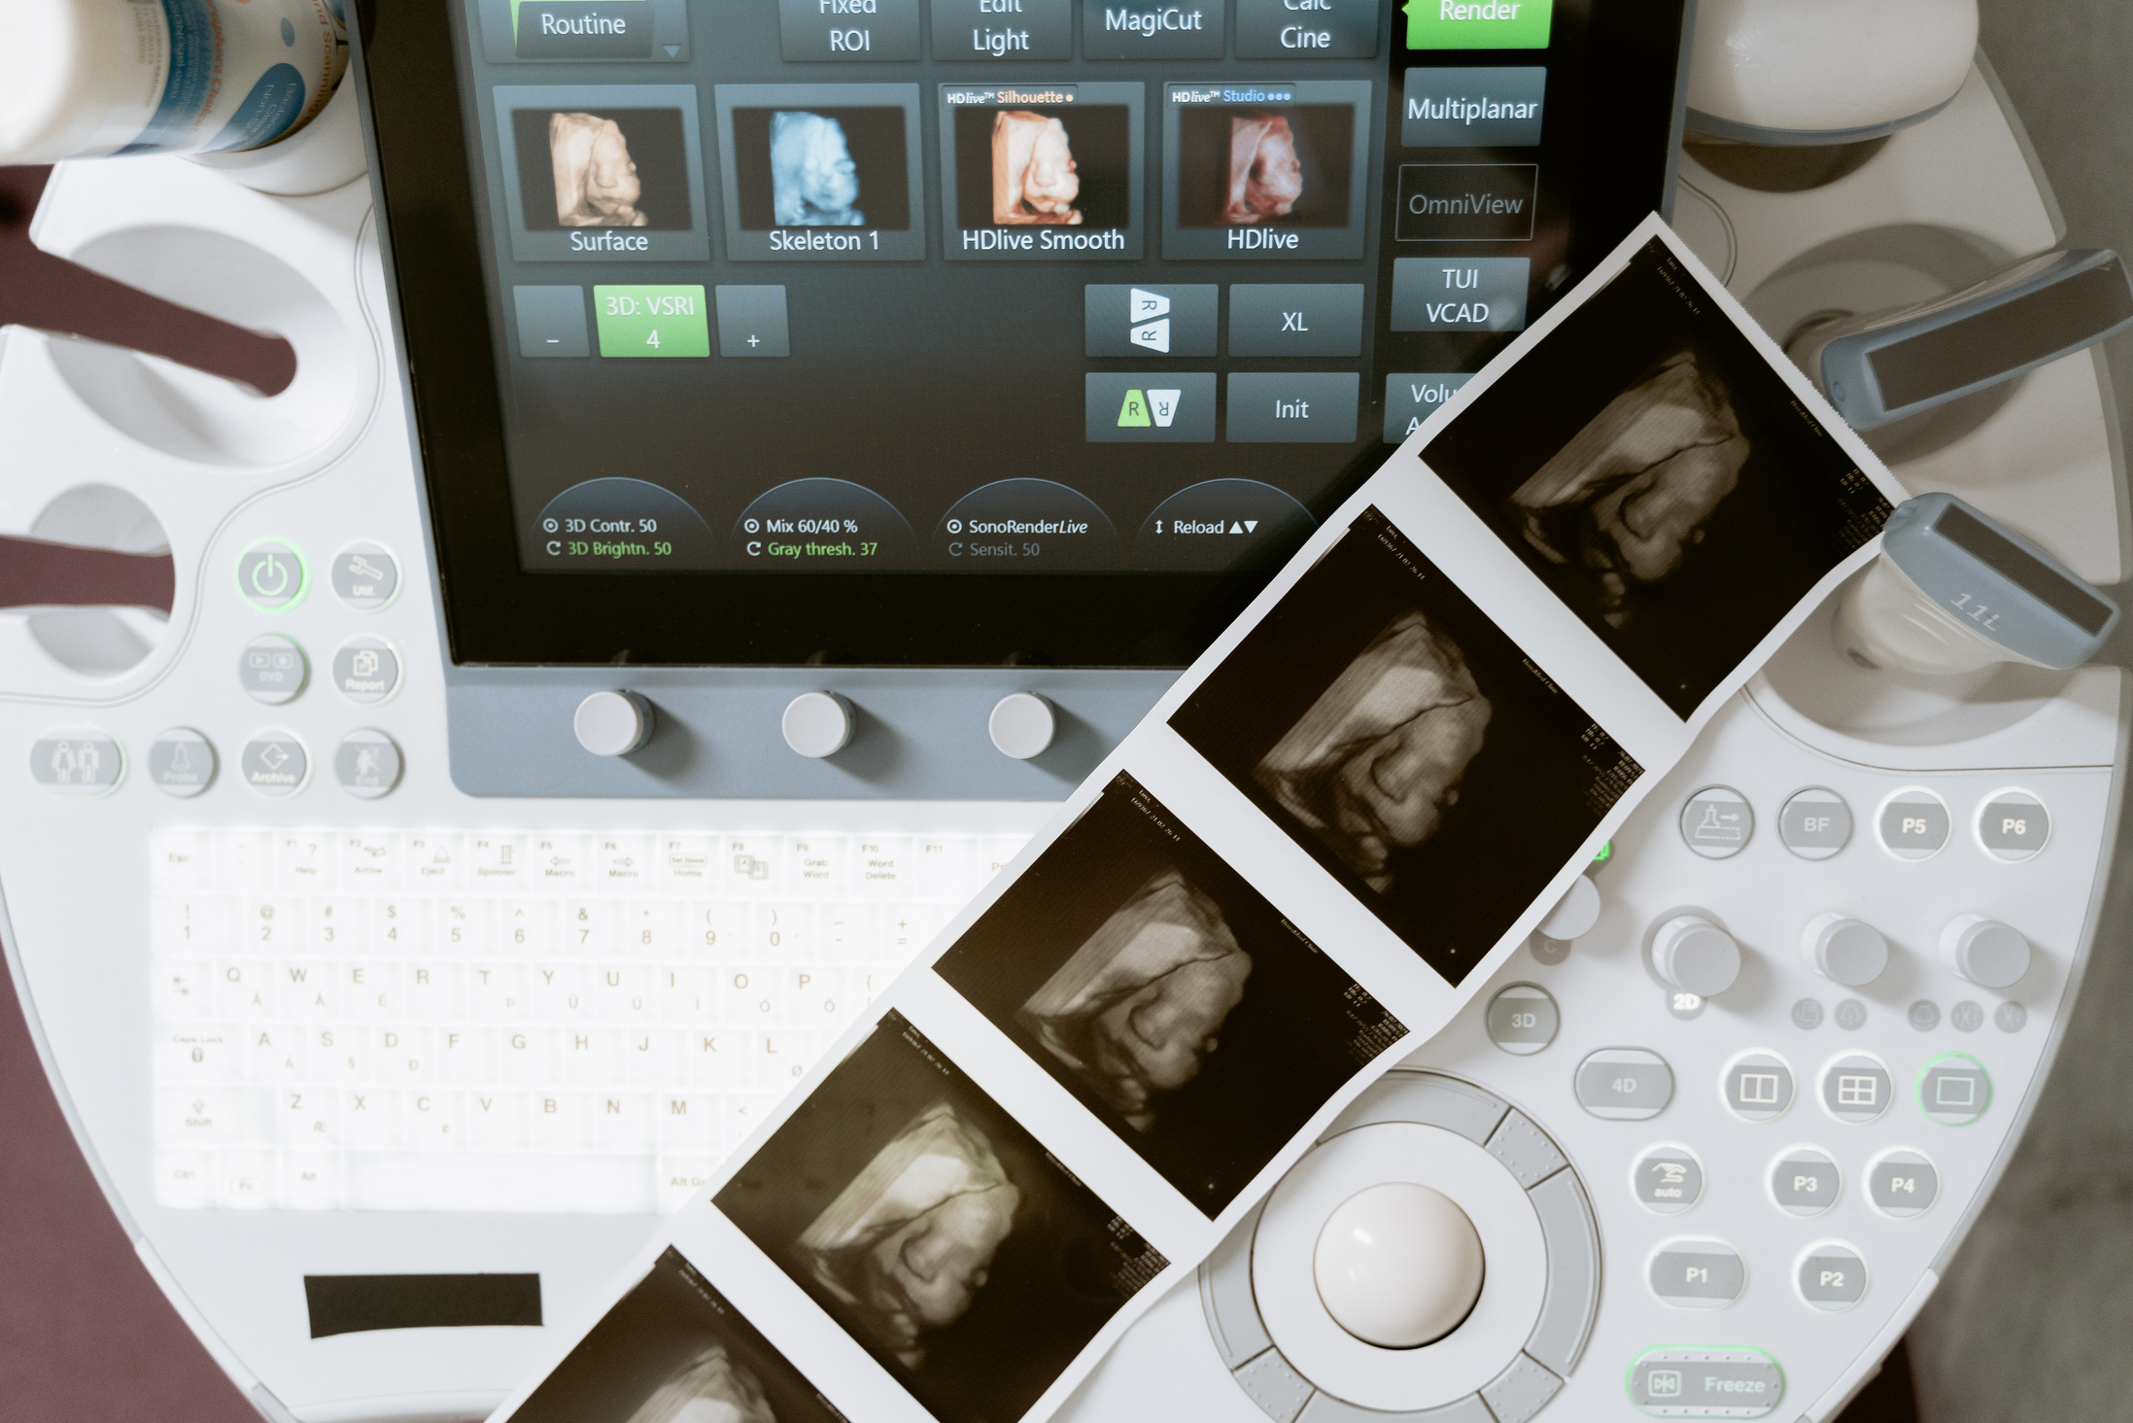
THE
ABORTION
AMENDMENT
IN VIRGINIA
“
That every individual has the fundamental right to reproductive freedom and that the right to make and effectuate one's own decisions about all matters related to one's pregnancy cannot be denied, burdened, or otherwise infringed upon by the Commonwealth, unless justified by a compelling state interest and achieved by the least restrictive means. The amendment prohibits the Commonwealth from penalizing, prosecuting, or otherwise taking adverse action against an individual for exercising the individual's right to reproductive freedom or for aiding another individual in the exercise of such right, unless justified by a compelling state interest.
“
WHAT COULD HAPPEN IN VA

Slide 3

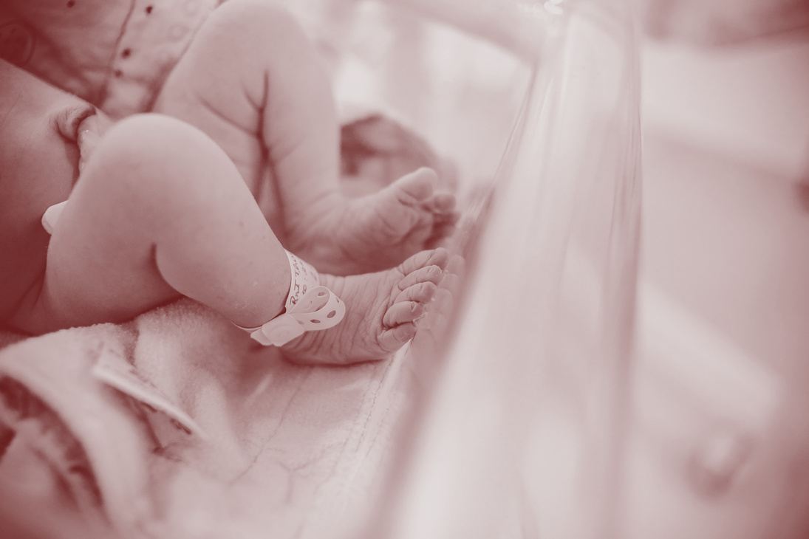

BIRTHDAY ABORTIONS
Abortion will be allowed up until the moment of birth for any reason. Currently, Virginia allows abortions into the third trimester, with restrictions. That will no longer be the case under this amendment.
BABIES LEFT TO DIE
Babies who survive an abortion attempt will not be given reasonable, life-saving care. Abortionists
will be legally allowed to deliver the baby and let it
die on a medical table.
PARENTAL RIGHTS UNDERMINED
This amendment eliminates the right of parents
to know about or consent to their young child's invasive abortion surgery.

Slide 4



TRANSGENDER SURGERIES
“Reproductive Freedom” is an umbrella term that
is not limited to women. Under this amendment men, women, and minors would also have a right to sterilization and therefore transgender surgeries.
CULTURE OF DEATH
Under 50 years of Roe, the view of life decayed among Americans. Under this amendment, the respect for life will only worsen among Virginians. If we don't value life at its earliest stages, we won't value it at end of life.
ABORTION TOURISM
Virginia will become the Abortion Capital of the
South. Since Dobbs, there has already been a 30% increase in out-of-state abortions occurring in Virginia.

Slide 5
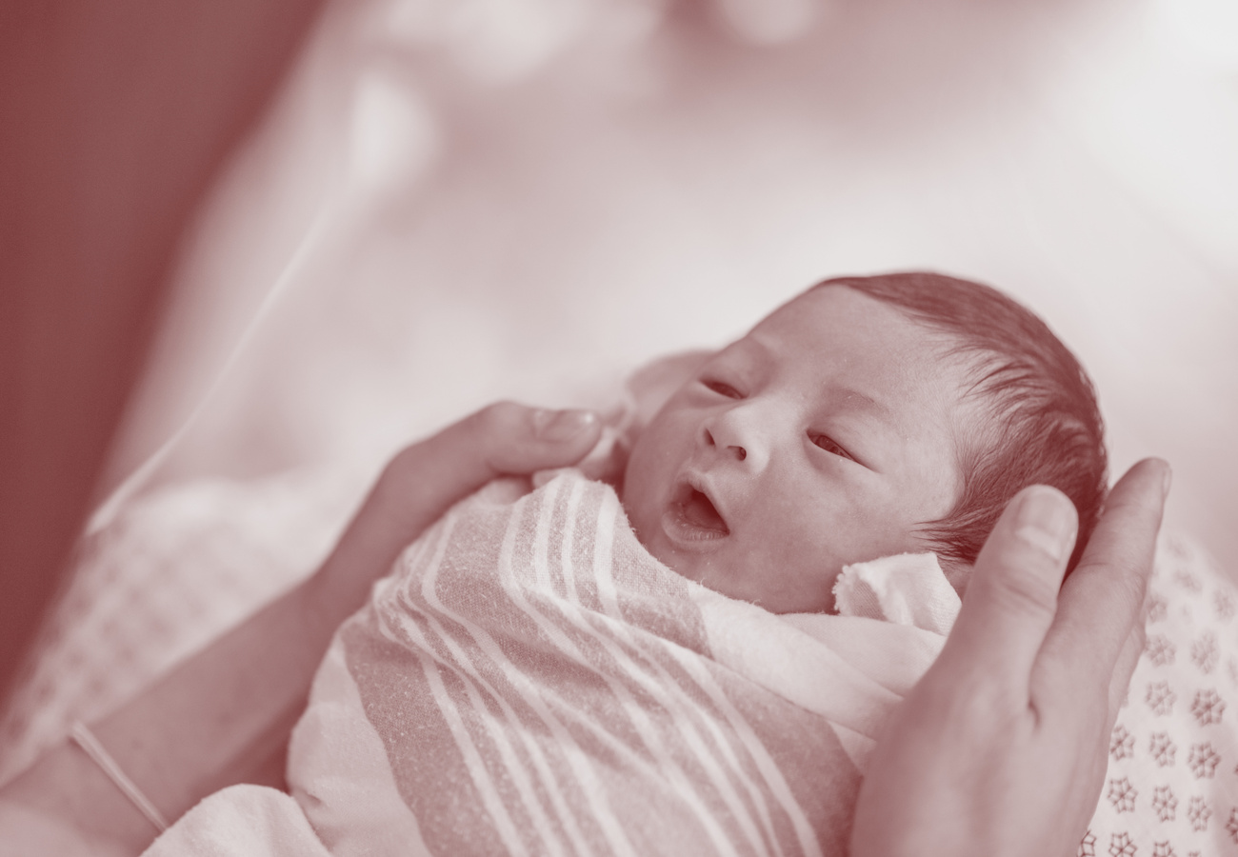
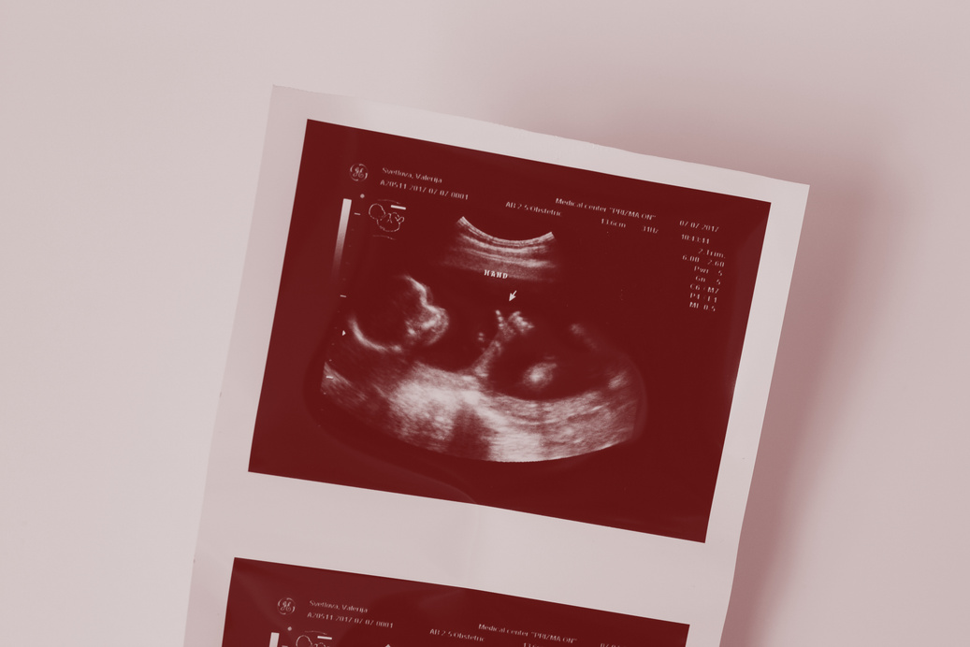
COUNTLESS MORE DEATHS
Virginia saw over 35,000 children die in 2023 from abortion, and Virginia’s annual volume of abortions grew 103% in the past 6 years. With no restrictions,
no limits and no life-saving measures, the lives lost will only increase.
EXPLOITATION OF EMBRYOS
The open-ended and undefined phrase “reproductive freedom” would allow for the unregulated sale and purchase of human embryos, and unethical
research, commodifying human beings and leading to the exploitation of women.

Slide 6

THE
ABORTION
AMENDMENT
IN VIRGINIA
TIMELINE
TIMELINE
STEP 01
STEP 03
FIRST
SESSION: 2025
SECOND
SESSION: 2026
• The amendment has to be
• approved by both legislative
• chambers.
• Amendments cannot be vetoed by
• the governor.
• The amendment is introduced
• again.
• The language of the amendment
• cannot be altered.
• The amendment must pass both
• chambers.
STEP 02
STEP 04
ELECTION:
NOVEMBER 2025
BALLOT: 2026
• The bill as passed twice goes to the
• ballot for the people to decide.
• People vote yes/no to add the
• language to the state constitution.
• An election of the House of
• Delegates must occur before the
• amendment is taken up again.
VOTE PRO-LIFE
ON 11.3.26

Slide 7



GET INFORMED
To Learn More About The Amendment Visit
NOABORTIONAMENDMENT.COM
PROTECT LIFE
Spread Awareness and Support Your Local PRC
care net peninsula
we have resources
to help you
spread the word!
VOTE
Get Out and Vote PRO-LIFE On
November 3, 2026

