Slide 1



CNPENINSULA.ORG/NOABORTIONAMENDMENT

Slide 2
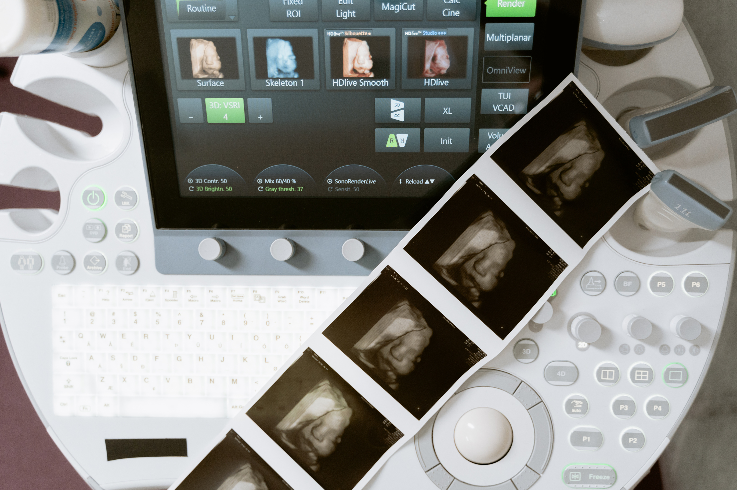
ABORTION
THE
AMENDMENT
IN VIRGINIA
“
That every individual has the fundamental right to reproductive freedom and that the right to make and effectuate one's own decisions about all matters related to one's pregnancy cannot be denied, burdened, or otherwise infringed upon by the Commonwealth, unless justified by a compelling state interest and achieved by the least restrictive means. The amendment prohibits the Commonwealth from penalizing, prosecuting, or otherwise taking adverse action against an individual for exercising the individual's right to reproductive freedom or for aiding another individual in the exercise of such right, unless justified by a compelling state interest.
“
WHAT COULD HAPPEN IN VA

Slide 3



OVERREGULATION OF PREGNACY CENTERS
Pregnancy Centers could be guilty of “denying, burdening, or infringing” on a Virginia Citizen’s reproductive freedom by not offering or referring for abortions. Pregnancy Centers are already involved in lawsuits in 7 states and counting.
BIRTHDAY ABORTIONS
Abortion will be allowed up until the moment of birth for any reason. Currently, Virginia allows abortions into the third trimester, with restrictions. That will no longer be the case under this amendment.
PARENTAL RIGHTS UNDERMINED
This amendment eliminates the right of parents
to know about or consent to their young child's invasive abortion surgery.

Slide 4



TRANSGENDER SURGERIES
“Reproductive Freedom” is an umbrella term that
is not limited to women. Under this amendment men, women, and minors would also have a right to sterilization and therefore transgender surgeries.
BABIES LEFT TO DIE
Babies who survive an abortion attempt will not be given reasonable, life-saving care. Abortionists
will be legally allowed to deliver the baby and let it
die on a medical table.
ABORTION TOURISM
Virginia will become the Abortion Capital of the
South. Since Dobbs, there has already been a 30% increase in out-of-state abortions occurring in Virginia.

Slide 5
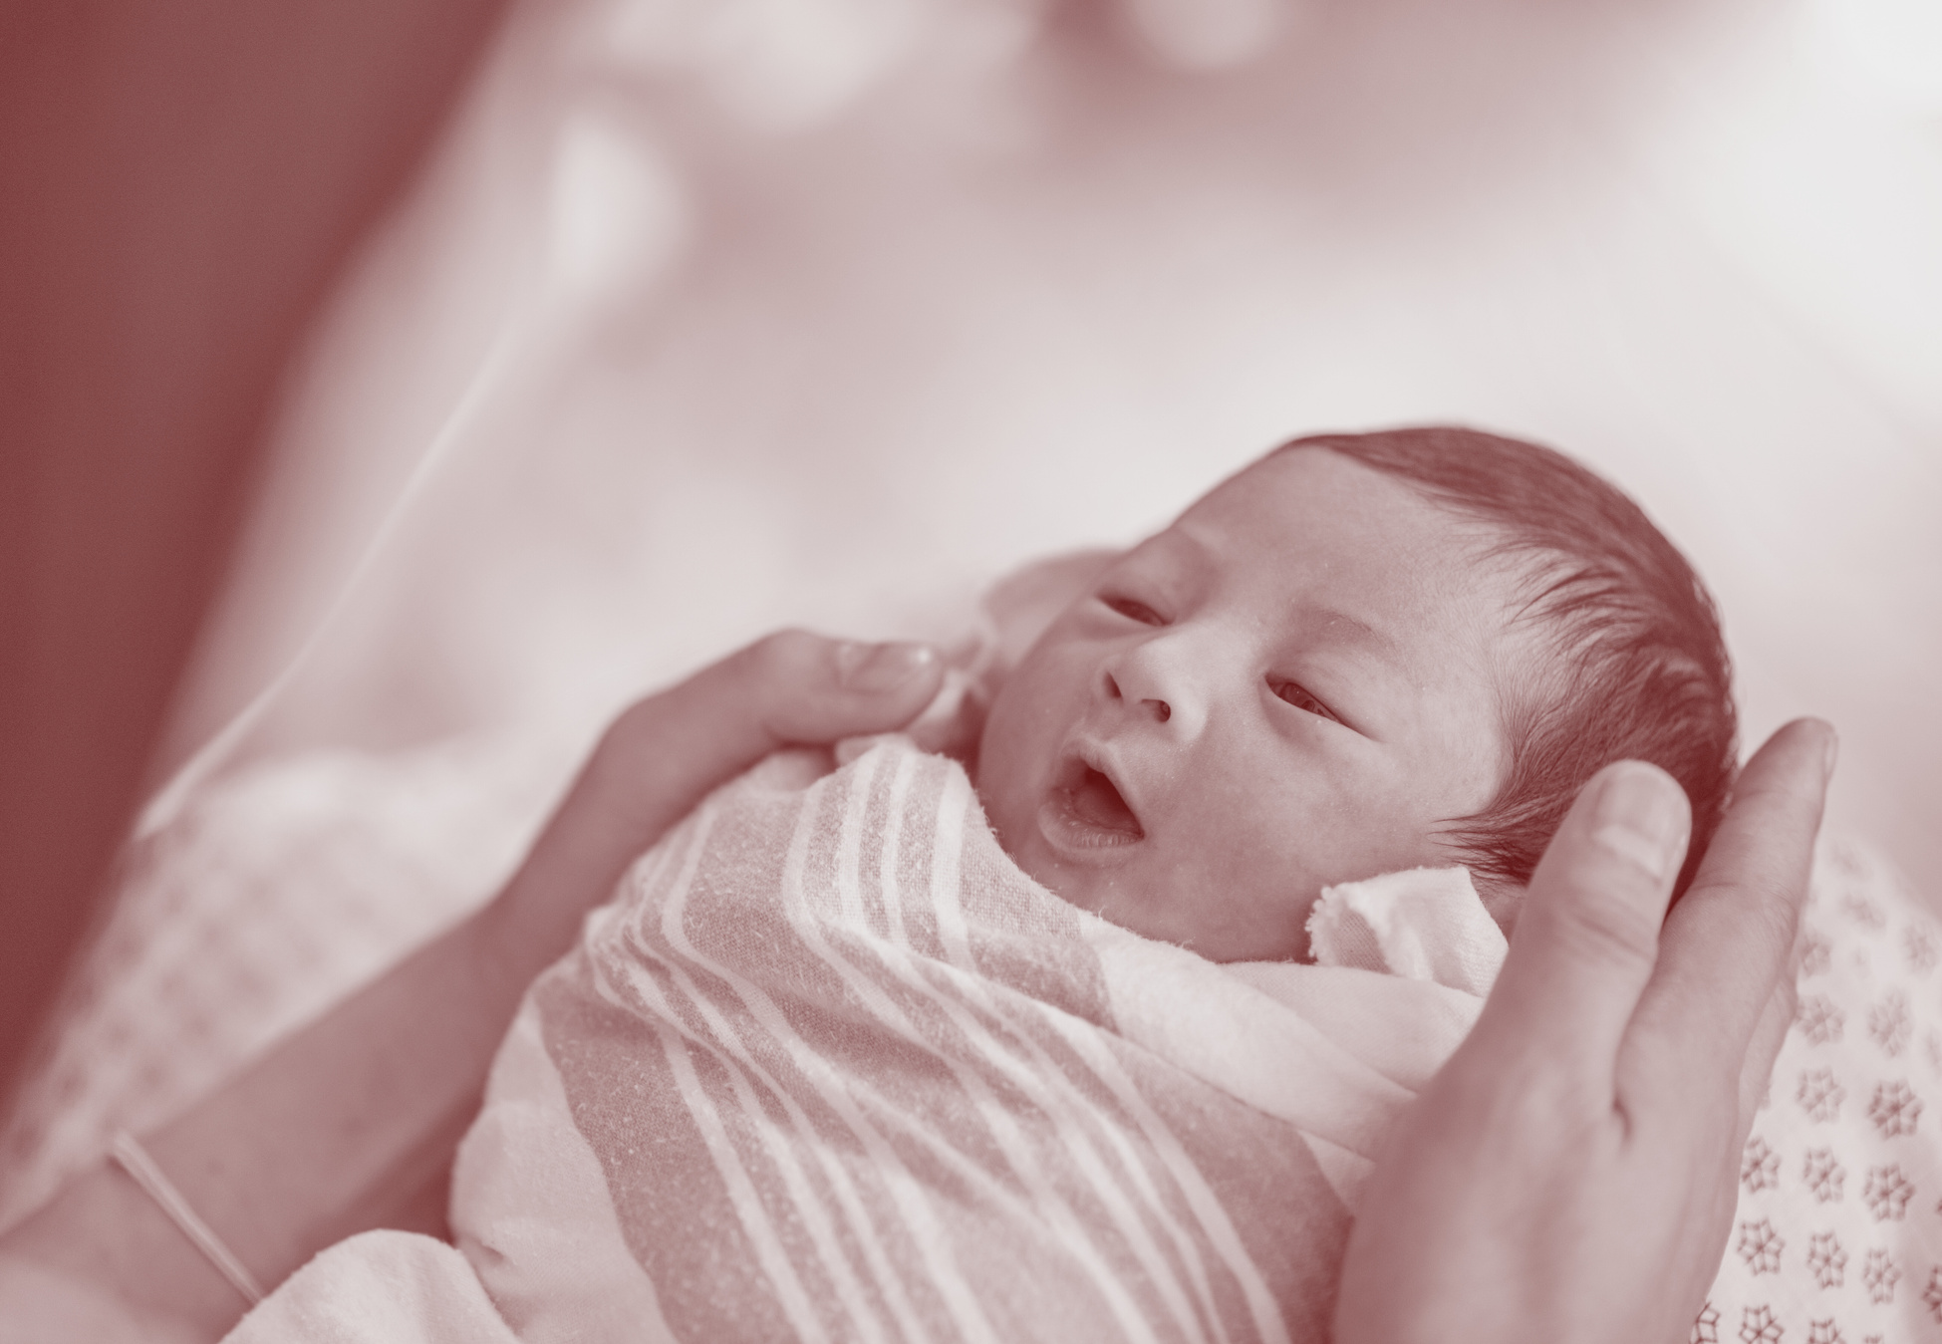
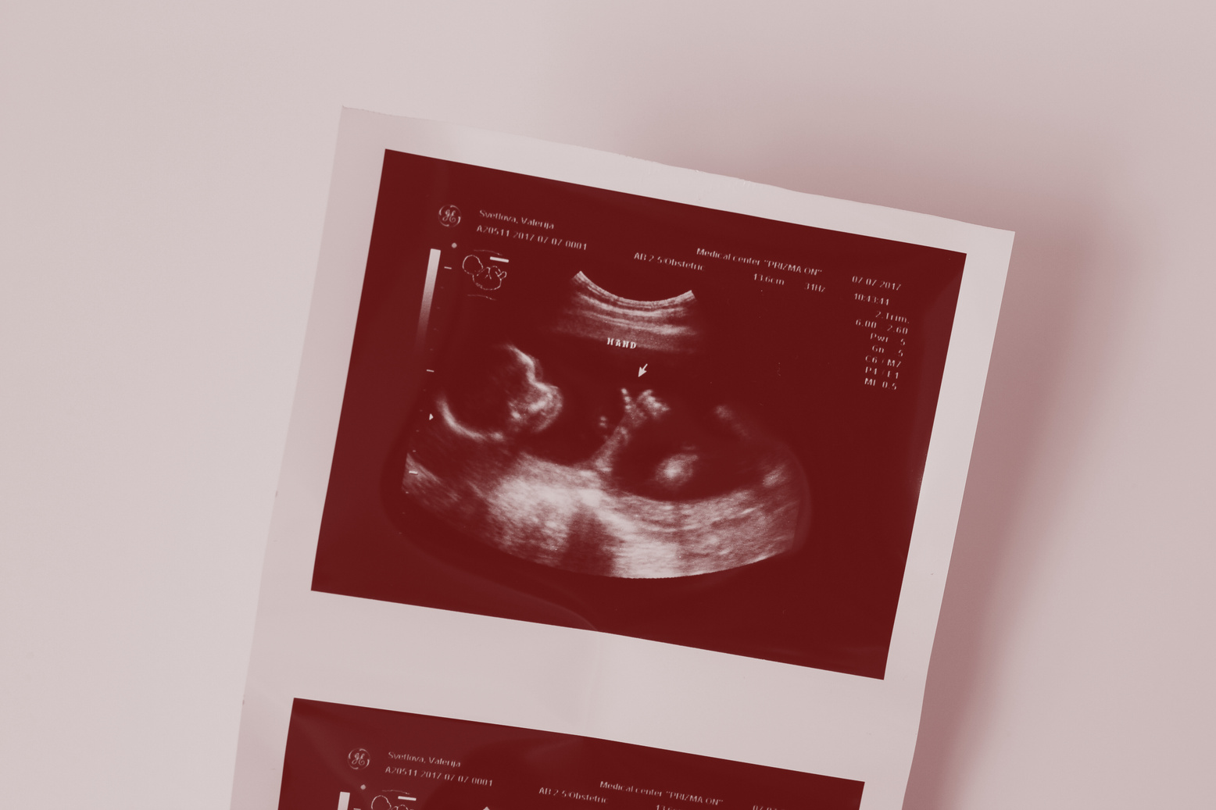
COUNTLESS MORE DEATHS
Virginia saw over 35,000 children die in 2023 from abortion, and Virginia’s annual volume of abortions grew 103% in the past 6 years. With no restrictions,
no limits and no life-saving measures, the lives lost will only increase.
EXPLOITATION OF EMBRYOS
The open-ended and undefined phrase “reproductive freedom” would allow for the unregulated sale and purchase of human embryos, and unethical
research, commodifying human beings and leading to the exploitation of women.

Slide 6

IF ABORTION BECOMES A
CONSTITUTIONAL RIGHT IN VIRGINIA ...
Your Local Pregnancy Center Could be Exposed to Lawsuits Medical Providers and PRCs are Facing Across the U.S.

Slide 7























THERE IS AN
OPTION TO REVERSE
THE ABORTION PILL
False Advertising
Saving Lives, Under Investigation
Collusion or Consumer Protection?
NIFLA VS BONITA (CALIFORNIA)
BELLA HEALTH & MYNYK VS
WEISTER (COLORADO)
FIRST CHOICE VS PLATKIN
(NEW JERSEY)
The California Attorney General sued pregnancy centers for discussing the Abortion Pill Reversal (APR) using progesterone.
Colorado laws prohibit APR and are investigating providers who offer it, like Nurse Mynyk.
The AG worked with Planned Parenthood and targeted a pro-life group with subpoenas based on beliefs.
13 Years of Records
Helping Isn’t Allowed
Warning Labels
PREGNANCY RESOURCE
CENTERS AHEAD
MAY PROVIDE LIFE-AFFIRMING
OPTIONS, SUPPORT, AND FREE CARE.
OBRIA GROUP VS FERGUSON
(WASHINGTON)
NIFLA VS CLARK (VERMONT)
MASSACHUSETTS
PRIVATE
Laws restrict non-medical staff at PRCs
from offering over-the-counter pregnancy
tests or counseling.
Massachusetts launched a state campaign warning against pregnancy centers, calling them harmful despite their free support services.
The AG issued sweeping Civil Investigative Demands 13+ years of records without proof of wrongdoing.
ATTENTION:
ALL PROVIDERS
MUST PERFORM
OR REFER FOR
ABORTIONS
Misleading
False Advertising
ABORTION
PILL
REVERSAL
NIFLA VS JAMES (NEW YORK)
NIFLA VS TRETO (ILLINOIS)
The New York AG sued pro-life centers under business fraud laws for talking about the Abortion Pill Reversal.
Laws force pro-life medical staff to refer for
abortions, violating conscience rights.

Slide 8

THE
ABORTION
AMENDMENT
IN VIRGINIA
TIMELINE
TIMELINE
STEP 01
STEP 02
STEP 03
STEP 04
FIRST
SESSION: 2025
ELECTION:
NOVEMBER 2025
SECOND
SESSION: 2026
BALLOT: 2026
• The bill as passed twice goes to the
• ballot for the people to decide.
• People vote yes/no to add the
• language to the state constitution.
• The amendment has to be
• approved by both legislative
• chambers.
• Amendments cannot be vetoed by
• the governor.
• An election of the House of
• Delegates must occur before the
• amendment is taken up again.
• The amendment is introduced
• again.
• The language of the amendment
• cannot be altered.
• The amendment must pass both
• chambers.
VOTE PRO-LIFE
ON 11.4.25

Slide 9



GET INFORMED
To Learn More About The Amendment Visit:
cnpeninsula.org/NOABORTIONAMENDMENT.COM
PROTECT LIFE
Spread Awareness and Support Your Local PRC
care net peninsula
we have resources
to help you
spread the word!
VOTE
Get Out and Vote PRO-LIFE On
November 4, 2025

Slide 10
CHURCH RESOURCES
CNPENINSULA.ORG/NOABORTIONAMENDMENT
  PDF ONE-PAGERS
  SLIDE DECK
  SOCIAL MEDIA GRAPHICS
  CNP STAFF/BOARD SPEAKING
  EXECUTIVE DIRECTOR VIDEO
  Content available in Canva upon request

